Slide 1
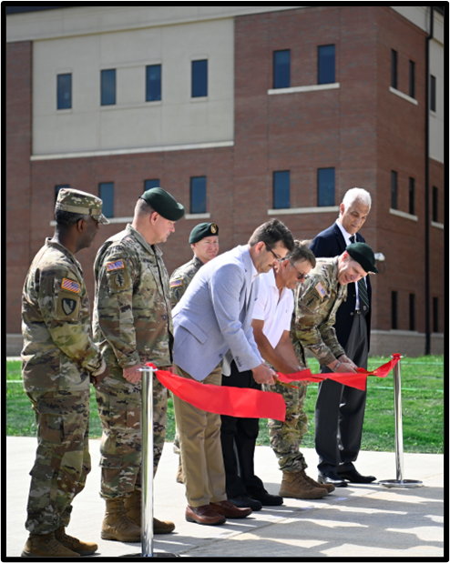
DOING BUSINESS
WITH usace
WILMINGTON DISTRICT
FY25 + Program Overview

Slide 2
MILCON – FORT BRAGG
FY | Project | Location | Value | Solicitation | Acquisition Strategy | Estimated Advertise Date
26 | Mission Command Center | JSOC | $100M – 150M | UR | DBB | FY26 2nd QTR
27 | SOF Equipment Development Facility | ATF | $25M - 50M | TBD | DBB | FY27 2nd QTR
27 | SOF Ammo Supply Point Phase 1 | SOTF | Phase 1 $50M - 100M | UR | DBB | FY27 3rd QTR
27 | FOB Freedom Upgrades | Camp Mackall | $20 - 50M | TBD | DBB | FY27 2nd QTR
28 | SOF Ammo Supply Point Phase 2 | SOTF | Phase 2 $50M - 100M | UR | DBB | FY28 2nd QTR
28 | SOF Joint Intelligence Center | SOTF | $50M - 100M | TBD | DBB | FY28 1st QTR
29 | SOF SERE Training Facility | ATF | $10M - 25M | TBD | DBB | FY29 1st QTR
Note: Forecast information provided is an estimate. Acquisition strategies may vary depending upon the results of formal market research.

Slide 3
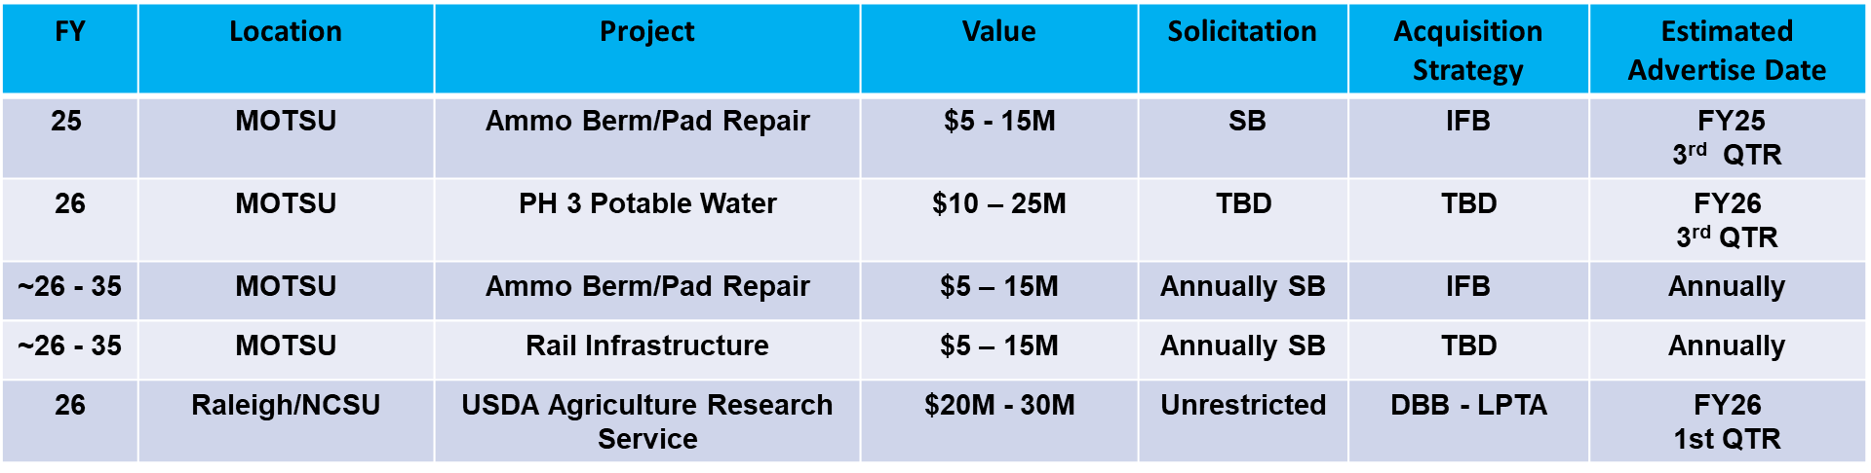
CIVIL WORKS CONSTRUCTION AND O&M
Note: Forecast information provided is an estimate. Acquisition strategies may vary depending upon the results of formal market research.

Slide 4
CIVIL WORKS CONSTRUCTION AND O&M
FY | Location | Project Name | Value | Solicitation | Acquisition Strategy | Estimated Advertise Date
25 | Greenville, NC | Greenville Utilities Commission (GUC) Streambank Protection Contract | $1M - 5M | 8(a) Competitive | IFB | FY25 3rd QTR
25 | Atlantic Intracoastal Waterway (AIWW), NC | AIWW Disposal Area Contract | $5M - 10M | Small Business | IFB | FY25 4th QTR
25 | Atlantic Intracoastal Waterway (AIWW), NC | AIWW Maintenance Dredging Contract | $5M - 10M | Small Business | IFB | FY25 4th QTR
26 | Atlantic Intracoastal Waterway (AIWW), NC | Snow’s Cut Erosion Control (Repair) Contract | $10M - 15M | TBD | IFB | FY27 2nd QTR
Note: Forecast information provided is an estimate. Acquisition strategies may vary depending upon the results of formal market research.

Slide 5
UPCOMING IDIQ CONTRACTS
FY | Location | Project | Value | Solicitation | Estimated Advertise Date
25 | WILMINGTON DISTRICT | Survey & Mapping | $6M Base plus 4 Option Years | Small Business | FY25 4th QTR
25 | MOTSU (1) | DB/General Construction SATOC | ~$35 – 40M Base plus 4 Option Years | Small Business | FY25 4th QTR
25 | Fort Bragg (1) | DB/General Construction SATOC | ~$35 - 40M Base plus 4 Option Years | Small Business | FY25 4th QTR
Note: Forecast information provided is an estimate. Acquisition strategies may vary depending upon the results of formal market research.

Slide 6
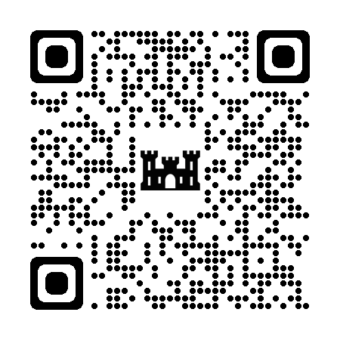
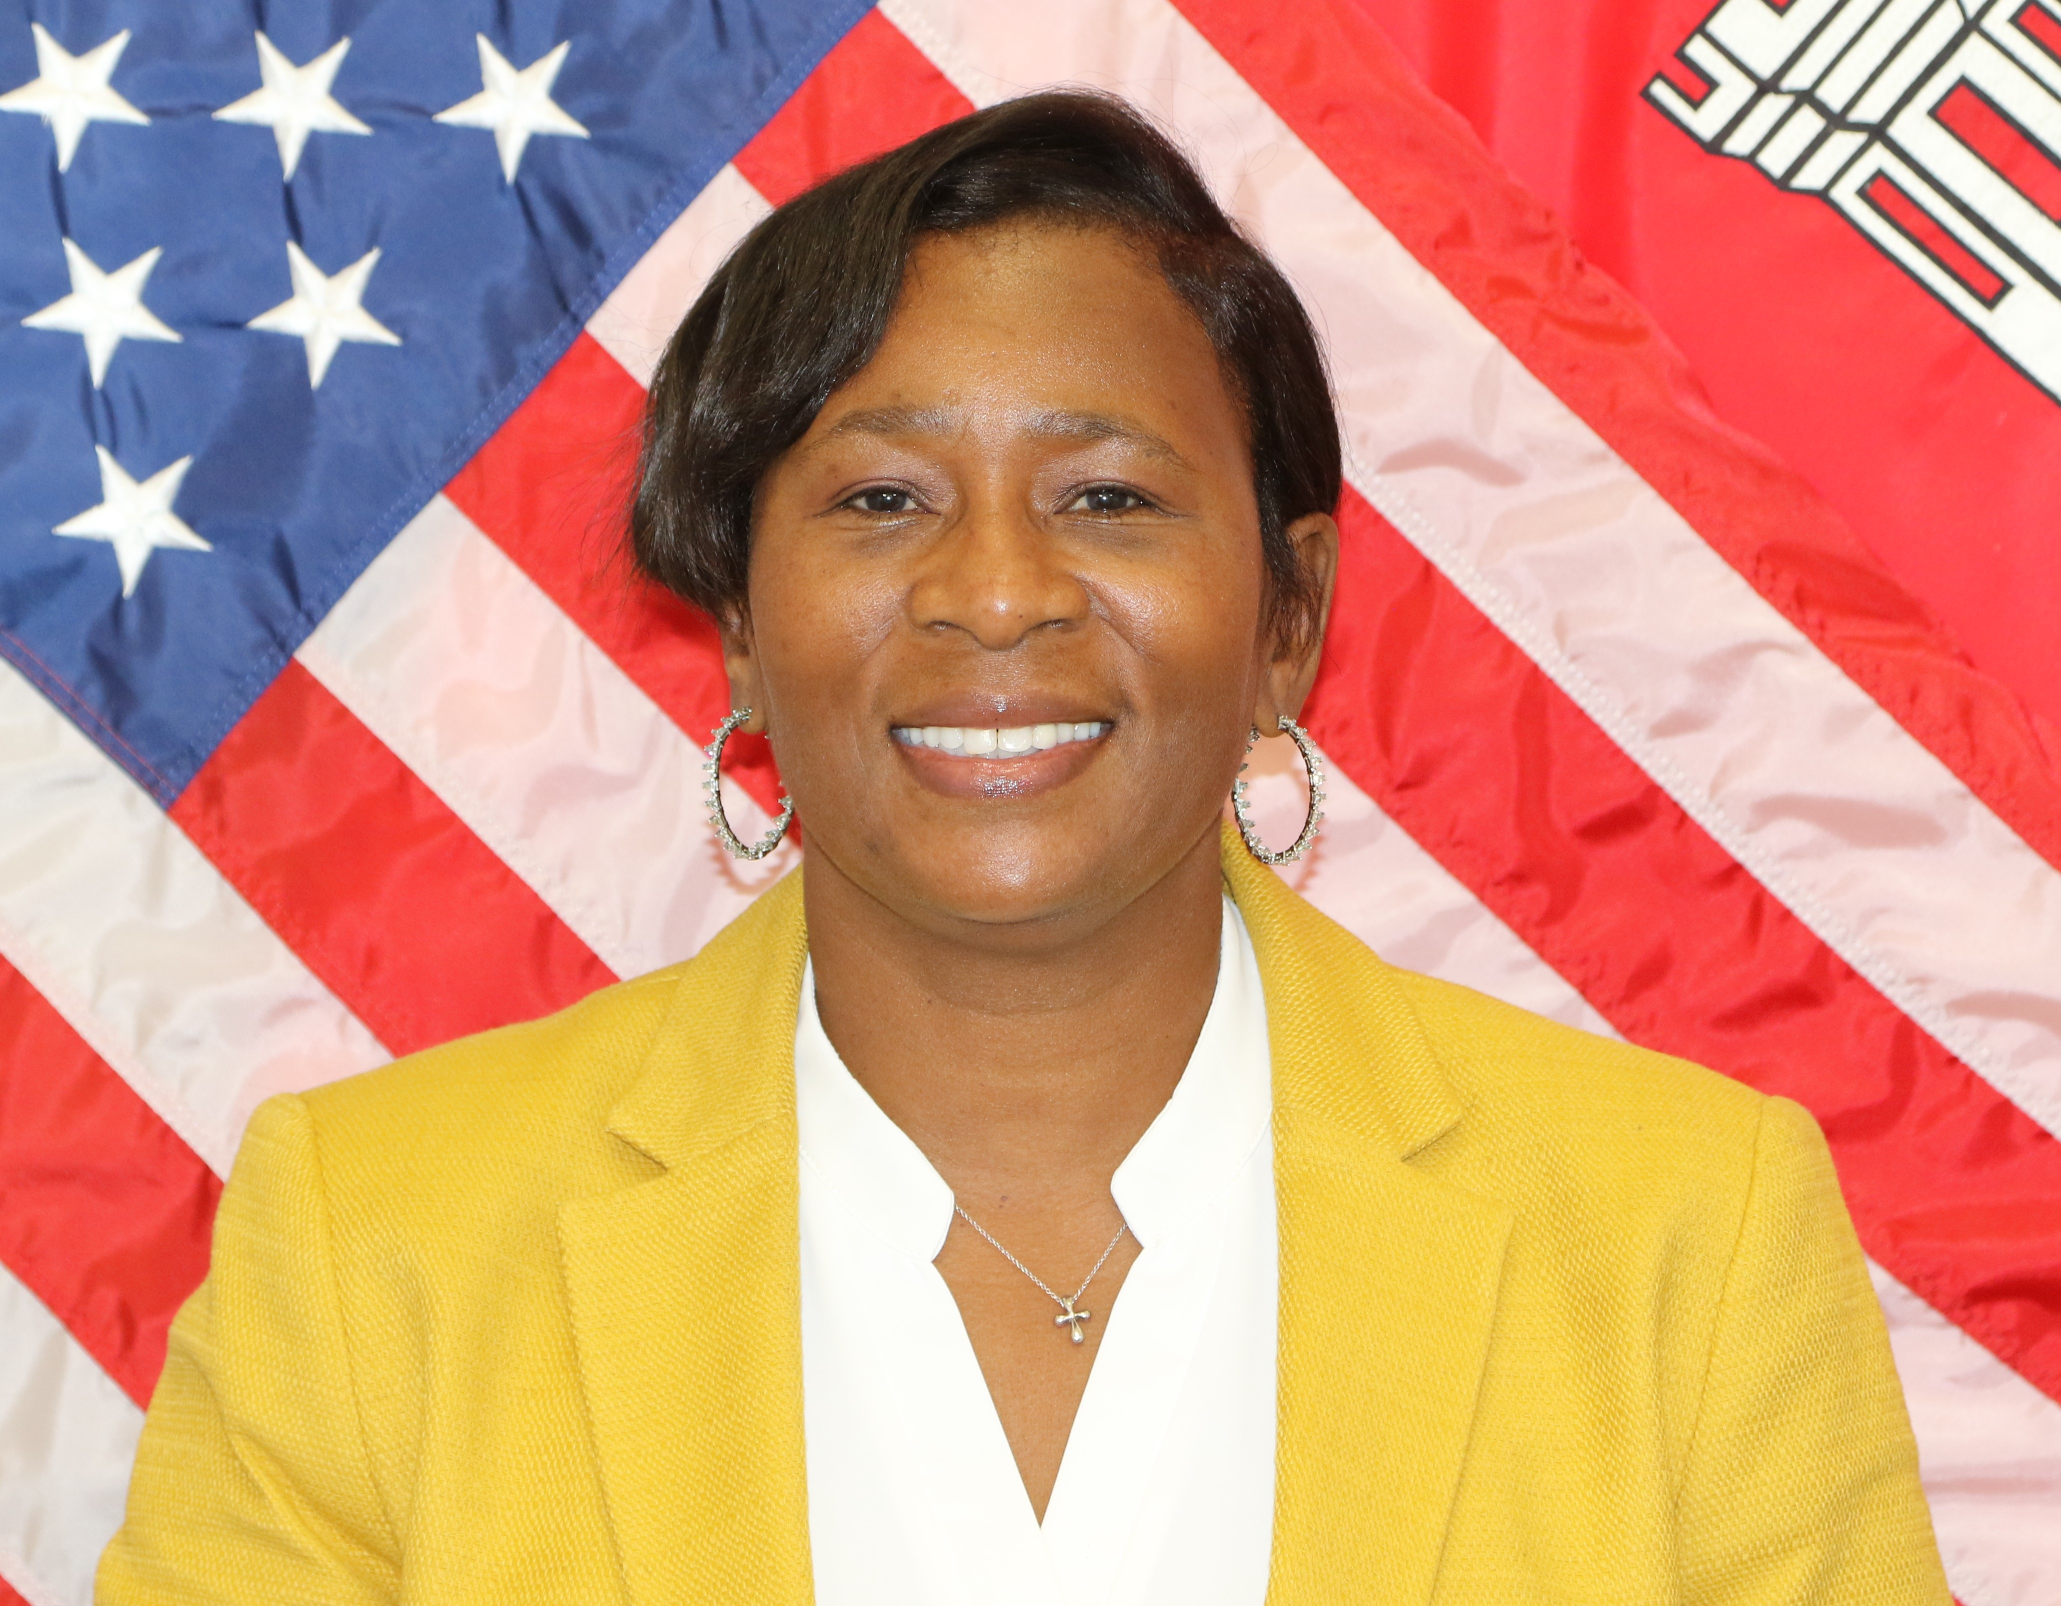
Contact Information
Andrea M. Green
Chief of Small Business Programs
USACE, Wilmington District
Office: (910)251-4452 / Mobile: 910-787-0340
Small Business Email: cesaw-sb@usace.army.mil
*Capability Briefings unavailable in 4th Quarter.

Slide 7


